Slide 1
PHP Form Handling and Database Connectivity

Slide 2
Introduction to PHP Global Variables - Superglobals
Some predefined variables in PHP are "superglobals", which means that they are always accessible, regardless of scope - and you can access them from any function, class or file without having to do anything special.
Thus, Super global variables are built-in variables that are always available in all scopes.
The PHP superglobal variables are:
$GLOBALS
$_SERVER
$_REQUEST
$_POST
$_GET
$_FILES
$_ENV
$_COOKIE
$_SESSION

Slide 3
PHP $_SERVER
$_SERVER is a PHP super global variable which holds information about headers, paths, and script locations.
The example below shows how to use some of the elements in $_SERVER:

Slide 4
PHP $_REQUEST
PHP $_REQUEST is a PHP super global variable which is used to collect data after submitting an HTML form.
When a user submits the data by clicking on "Submit", the form data is sent to the file specified in the action attribute of the <form> tag.
Then, we can use the super global variable $_REQUEST to collect the value of the input field:

Slide 5
PHP $_POST
PHP $_POST is a PHP super global variable which is used to collect form data after submitting an HTML form with method="post". $_POST is also widely used to pass variables.
We can use the super global variable $_POST to collect the value of the input field:

Slide 6
PHP $_GET
PHP $_GET is a PHP super global variable which is used to collect form data after submitting an HTML form with method="get".
$_GET can also collect data sent in the URL.

Slide 7
Form.php
<form action="display.php" method="post" id="nameform">
First Name: <input type="text" name="fname"></br>
Last Name: <input type="text" name="lname"></br>
<button type="submit" form="nameform" value="submit">Submit</button>
<button type="reset" value="Reset">Reset</button>
</form>
</form>
Note: When the user fills out the form above and clicks the submit button, the form data is sent for processing to a PHP file named “display.php". The form data is sent with the HTTP POST method.

Slide 8
Display.php(using POST method)
<?php
$first_name = $_POST['fname'];
$last_name = $_POST['lname'];
echo $first_name;
echo $last_name;
?>
OR

Slide 9
Display1.php(using GET method)
<?php
$first_name = $_GET['fname'];
$last_name = $_GET['lname'];
echo $first_name;
echo $last_name;
?>

Slide 10
Display2.php(using REQUEST method)
<?php
$first_name = $_REQUEST['fname'];
$last_name = $_REQUEST['lname'];
echo $first_name."<br>";
echo $last_name;
?>

Slide 11
GET vs. POST
Both GET and POST create an array (e.g. array( key1 => value1, key2 => value2, key3 => value3, ...))
Keys are the names of the form controls and values are the input data from the user.
Both GET and POST are treated as $_GET and $_POST.
These are superglobals, which means that they are always accessible, regardless of scope

Slide 12
When to use GET?
Information sent from a form with the GET method is visible to everyone (all variable names and values are displayed in the URL).
GET also has limits on the amount of information to send.
The limitation is about 2000 characters.
However, because the variables are displayed in the URL, it is possible to bookmark the page.
GET may be used for sending non-sensitive data.

Slide 13
When to use POST?
Information sent from a form with the POST method is invisible to others (all names/values are embedded within the body of the HTTP request)
No limits on the amount of information to send.
Because the variables are not displayed in the URL, it is not possible to bookmark the page.

Slide 14
Database Connectivity

Slide 15
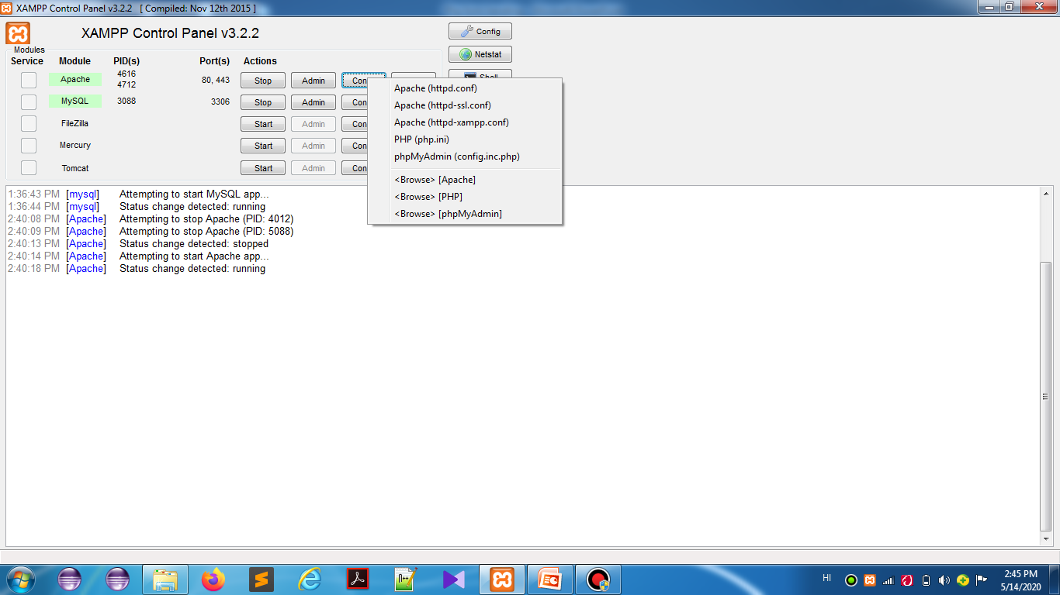

Slide 16
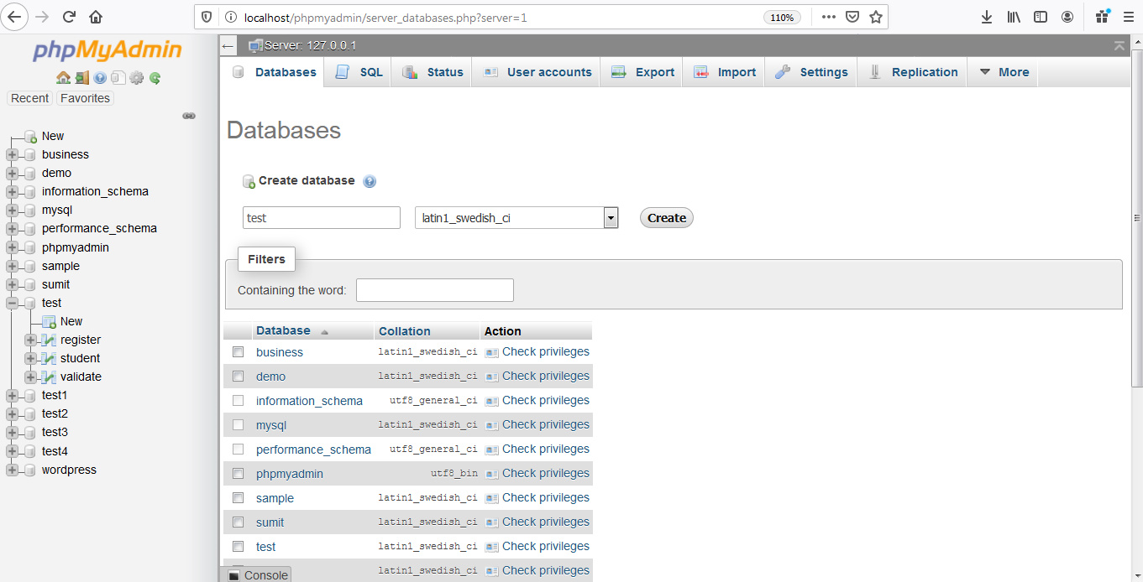

Slide 17
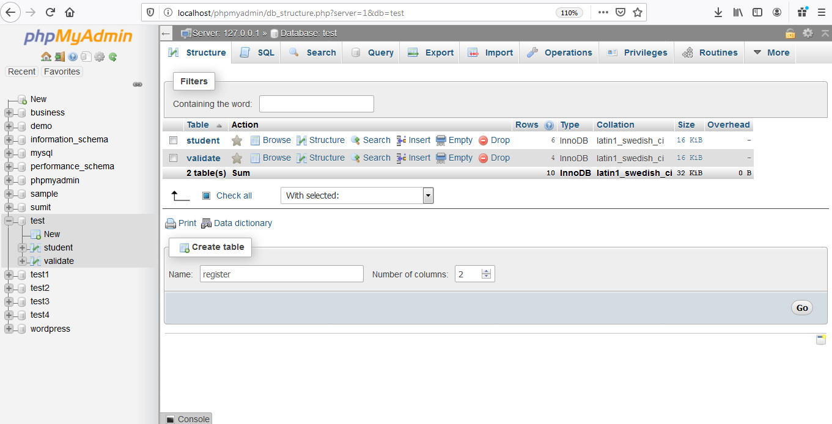

Slide 18
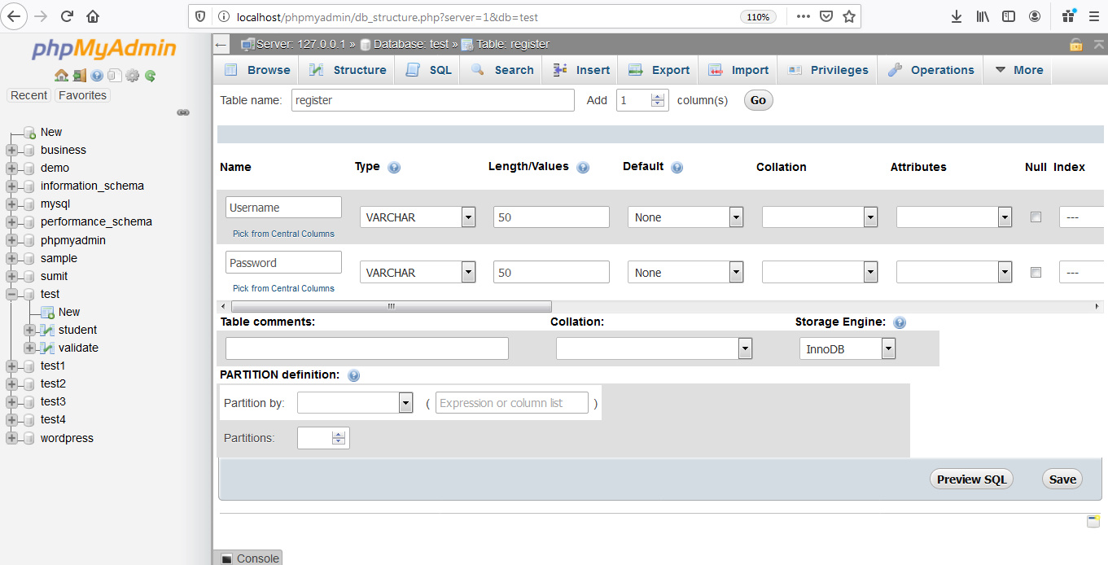

Slide 19
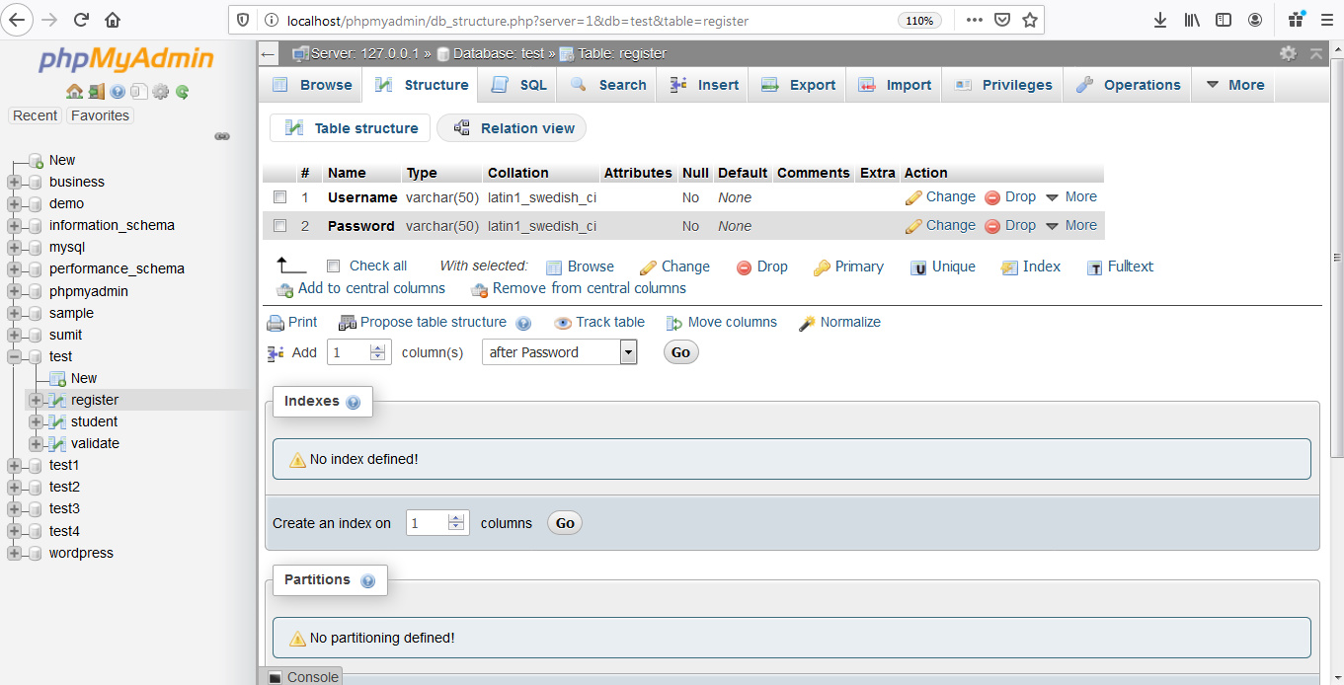

Slide 20
Insert Data into Database
<?php
$servername = "localhost";
$username = "root";
$password = "";
$dbname = "test"; // Go to localhost/phpmyadmin and then create the database test there
// Creating connection
$conn = new mysqli($servername, $username, $password, $dbname);
// Check connection
if ($conn->connect_error) {
die("Connection failed: " . $conn->connect_error);
}
$sql = "INSERT INTO register (Username, Password) VALUES ('A', 'X')";
if ($conn->query($sql) === TRUE) {
echo "New record created successfully";
} else {
echo "Error: " . $sql . "<br>" . $conn->error;
}
$conn->close();
?>

Slide 21
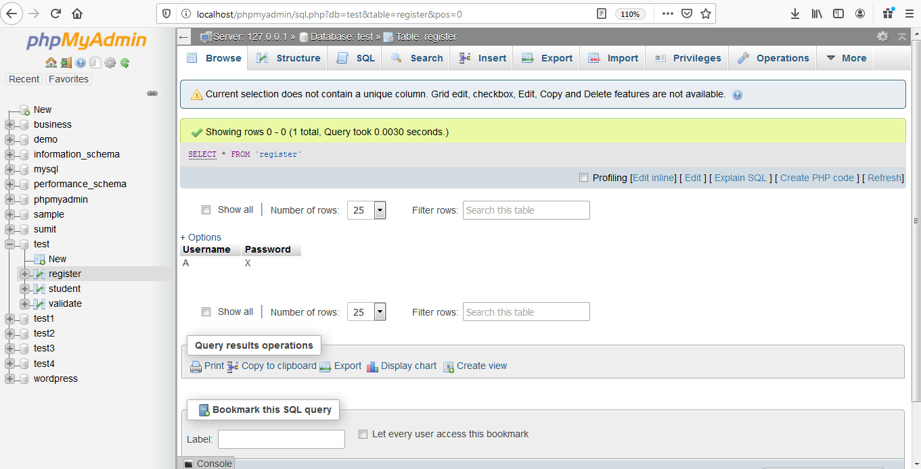

Slide 22
Fetch data from the database
<?php
$servername = "localhost";
$username = "root";
$password = "";
$dbname = "test";
// Create connection
$conn = new mysqli($servername, $username, $password, $dbname);
// Check connection
if ($conn->connect_error) {
die("Connection failed: " . $conn->connect_error);
}
$sql = "SELECT Username, Password from register";
$result = $conn->query($sql);
Contd..

Slide 23
if ($result->num_rows > 0) {
// output data of each row
while($row = $result->fetch_assoc()) {
echo "Username: " . $row["Username"]. " - Password: " . $row["Password"]."<br>";
}
} else {
echo "0 results";
}
$conn->close();
?>
Note: $result = $conn->query($sql);
This line of code runs the query and puts the resulting data into a variable called $result.
The function num_rows() checks if there are more than zero rows returned.
$row = $result->fetch_assoc()
The function fetch_assoc() puts all the results into an associative array that we can loop through.

Slide 24
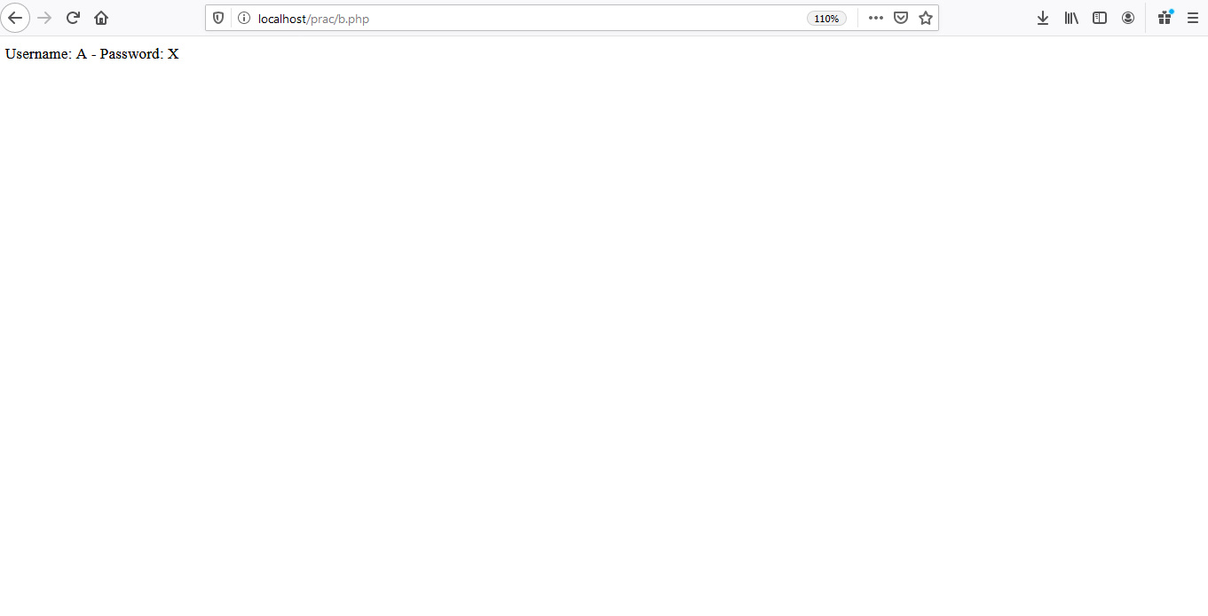

Slide 25
Inserting values into database using forms
Form1.html
<!DOCTYPE html>
<html>
<head>
<meta http-equiv="Content-Type" content="text/html; charset=ISO-8859-1">
</head>
<body>
<form method="post" action= "insert.php" >
<table border="1" >
<tr>
<td><label for="users_email">Email</label></td>
<td><input type="text"
name="users_email" id="users_email"></td>
</tr>
Contd..

Slide 26
Contd...
Contd..
<tr>
<td><label for="users_pass">Password</label></td>
<td><input name="users_pass"
type="password" id="users_pass"></input></td>
</tr>
<tr>
<td><input type="submit" value="Submit"/>
<td><input type="reset" value="Reset"/>
</tr>
</table>
</form>
</body>
</html>

Slide 27
insert.php
<?php
// Grab User submitted information
$email = $_POST["users_email"];
$pass = $_POST["users_pass"];
// Connect to the database
$conn = new mysqli("localhost","root","","test");
// Make sure we connected successfully
if($conn->connect_error)
{
die('Connection Failed'.$conn->connect_error);
}
$sql= "insert into validate(email, password) Values('$email','$pass')";
$result = $conn->query($sql);
if($result)
echo"Record added";
else echo"Record Could not be added";

Slide 28
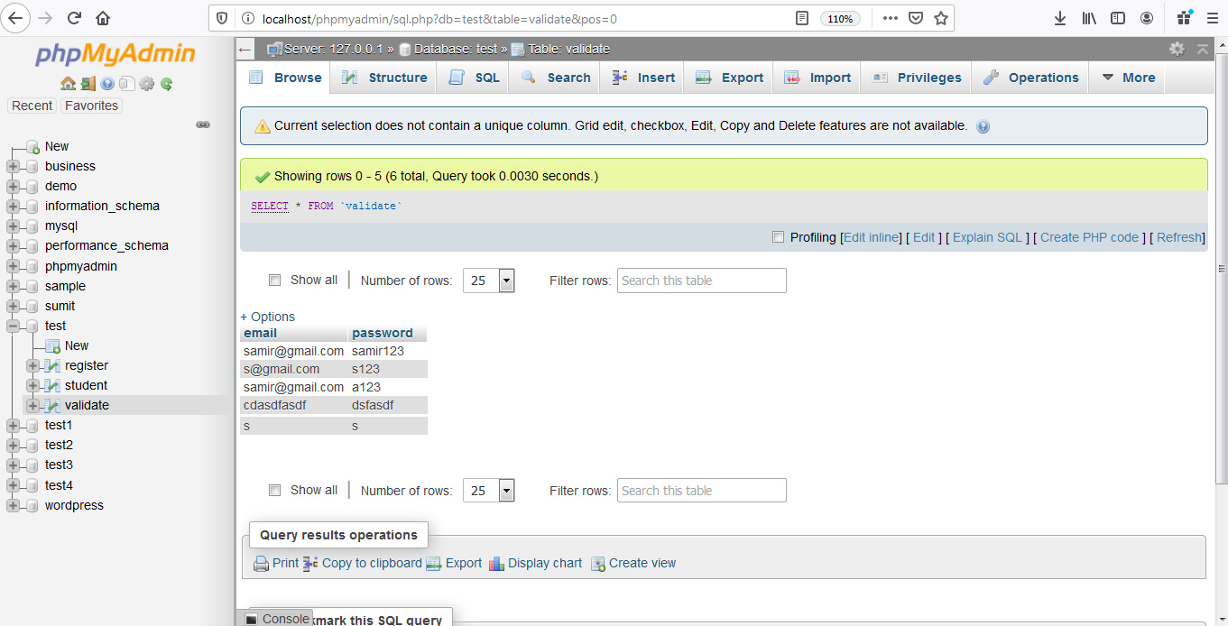

Slide 29
Checking for login after fetching values from the database
Form2.html
<!DOCTYPE html>
<html>
<head>
<meta http-equiv="Content-Type" content="text/html; charset=ISO-8859-1">
</head>
<body>
<form method="post" action= "login.php" >
<table border="1" >
<tr>
<td><label for="users_email">Email</label></td>
<td><input type="text"
name="users_email" id="users_email"></td>
</tr>
Contd..

Slide 30
Contd...
Contd..
<tr>
<td><label for="users_pass">Password</label></td>
<td><input name="users_pass"
type="password" id="users_pass"></input></td>
</tr>
<tr>
<td><input type="submit" value="Submit"/>
<td><input type="reset" value="Reset"/>
</tr>
</table>
</form>
</body>
</html>

Slide 31
login.php
<?php
// Grab User submitted information
$email = $_POST["users_email"];
$pass = $_POST["users_pass"];
// Connect to the database
$conn = new mysqli("localhost","root","","test");
// Make sure we connected successfully
if($conn->connect_error)
{
die('Connection Failed'.$conn->connect_error);
}
Contd..

Slide 32
Contd..
$sql="select email, password from validate where email='$email'";
$result = $conn->query($sql);
if ($result-> num_rows>0)
{
while($row=$result->fetch_assoc())
{
if($row['email']==$email && $row['password']==$pass)
echo"You are a validated user";
else
echo"Wrong password";
}
}
else echo "User does not exist";
?>

Slide 33
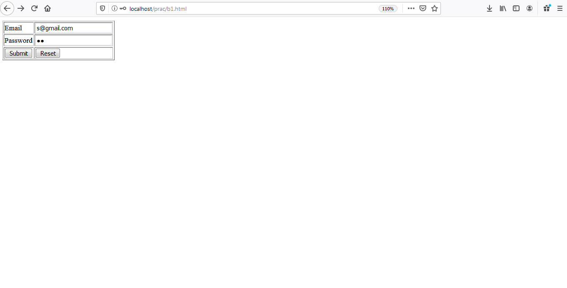

Slide 34
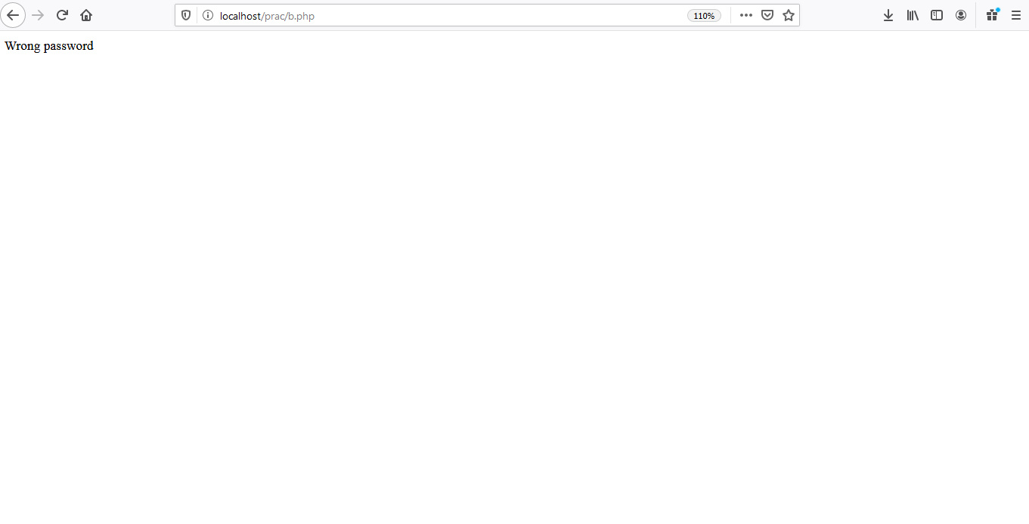

Slide 35


Slide 36
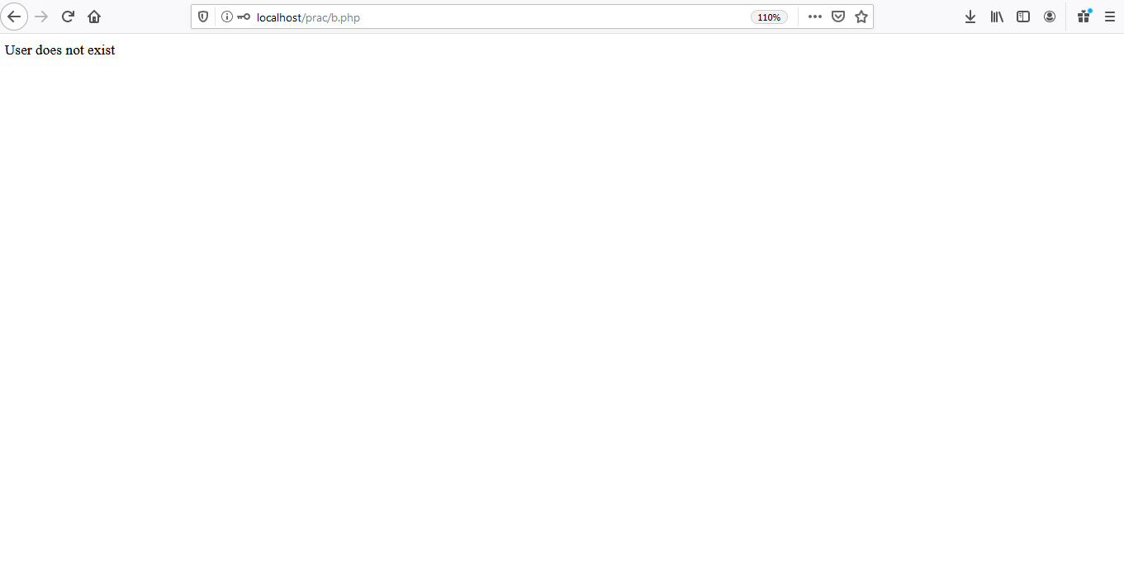

Slide 37


Slide 38


Slide 39
Thank You

